Slide 1
EDA Credit Risk
Submitted By
Bhawna Gupta
C-32 ML and AI Certification Program

Slide 2
Business Objectives
This company is the largest online loan marketplace, facilitating personal loans, business loans, and financing of medical procedures. Borrowers can easily access lower interest rate loans through a fast online interface.
Like most other lending companies, lending loans to ‘risky’ applicants is the largest source of financial loss (called credit loss). The credit loss is the amount of money lost by the lender when the borrower refuses to pay or runs away with the money owed. In other words, borrowers who default cause the largest amount of loss to the lenders. In this case, the customers labelled as 'charged-off' are the 'defaulters'.
If one is able to identify these risky loan applicants, then such loans can be reduced thereby cutting down the amount of credit loss. Identification of such applicants using EDA is the aim of this case study.

Slide 3
Dataset Details
Time period of Analysis: Applications received between 2007 to 2011
Fully Paid and Charged Off Application status considered for analysis
Dataset contains 39717 rows and 111 columns
Each row represents unique customer record
There are

Slide 4
Data Cleaning
Removed 54 columns with complete null values
Removed 20 columns related to loan application status – current
Further removed variables with title, description, id’s, sub grade – which are not relevant in analysis

Slide 5
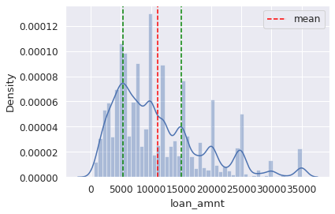
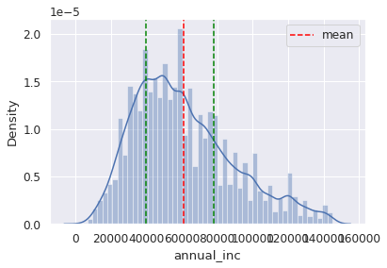
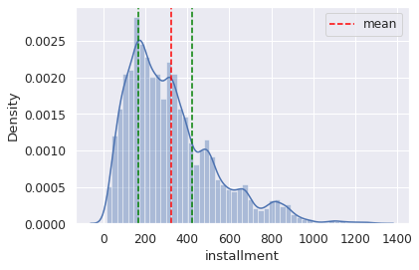
Data Transformations
Derive new column:
  Created year and month for Loan applications create date
Modified existing column:
  Changed interest rate variable from object to float variable and stripped off % symbol, so that numerical analysis can be done over the same
Variable Binning:
  Continuous variables have been bucket into categories to look at the distribution of each class such as – Loan amount, Annual income
    Further sub-setting of data has been performed by removing upper threshold values

Slide 6
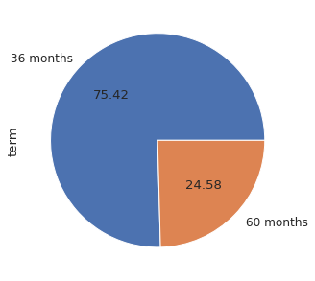
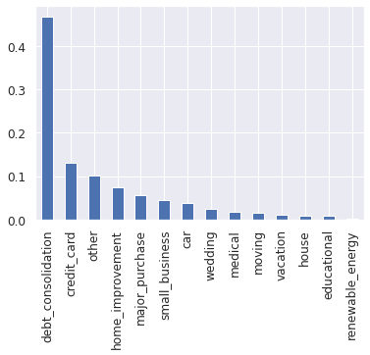
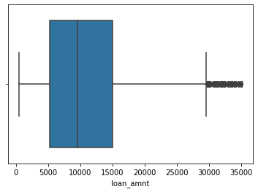
Univariate Analysis
Purpose of the loan: Debt consilidation has been purpose for more than 40% of loan applications
Duration of the loan for which loans are taken:
75% of the applications are given for 36months term loan
Distribution of Loan amount

Slide 7
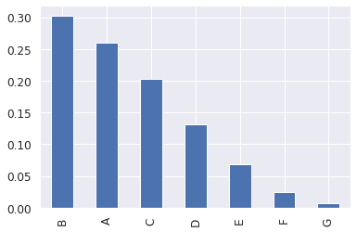
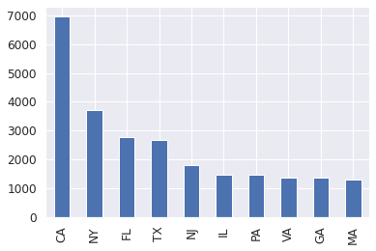
60% of the applications are considered for Grade - A,B and C
California, New York and Florida are the states where we have most of the customers

Slide 8
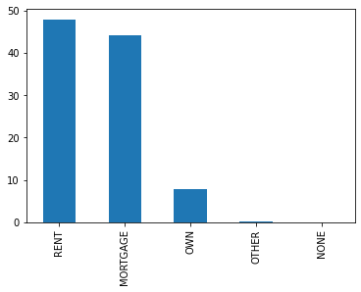
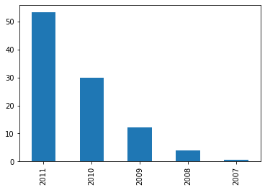
48% of application are given to Borrowers with Rented houses
44% of the Borrowers have houses on Mortgage
More than 50% of loan applications have received in 2011

Slide 9
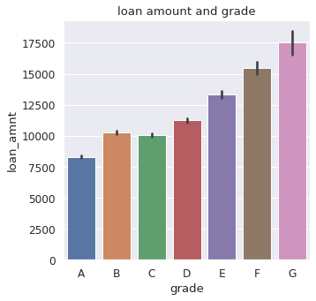
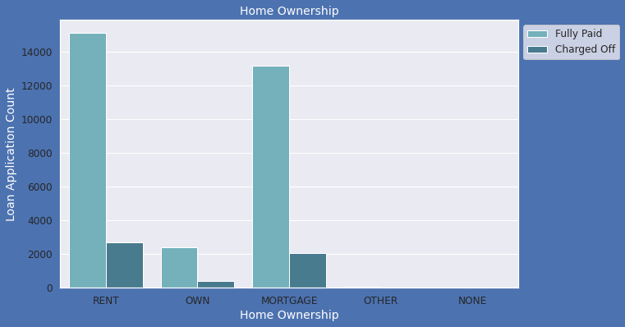
Bivariate Analysis
Average loan amount taken by Grade- G customers is higher
Most of applicants living in rented home or mortgaged their home.

Slide 10
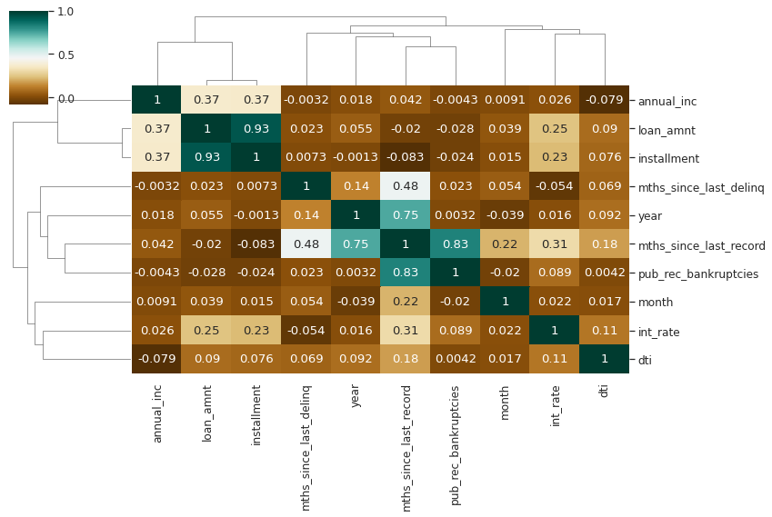
Correlations for Quantitative variables
Loan amount and installment is highly correlated. That means higher loans have bigger installments as well to be paid by borrower
Interest rate is negatively correlated to months since last deliquency. That means when customer defaults on loan payments, interest rate increases
Months since last deliquency is also negatively correlated to income. Which shows lower annual income of customer is related to the reason of deliquency
Annual income has negative relation to debt to income ratio(DTI), Bankrupcy (pub_rec_bankruptcies)

